Slide 1
Image distortions: blur and noise

Slide 2
Sources of distortions
Blur
  Light scatter (object to sensor)
  Imaging system optics
  Motion
Noise
  Dark current / thermal noise (salt – and – pepper)
  Shot noise (electric charge on electronic devices, e.g. CCD)
  Read-out noise (fluctuations in photon-to-electron-to-value conversion)

Slide 3
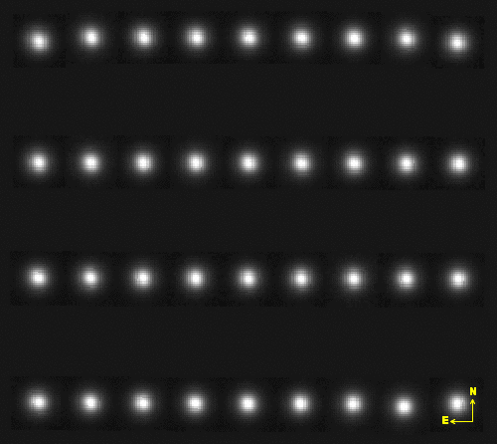
PSF - 2D spatial variations
http://clix.iap.fr/steeringroup/spica/872455p/qualityFITS/872455p_psf_m.png

Slide 4
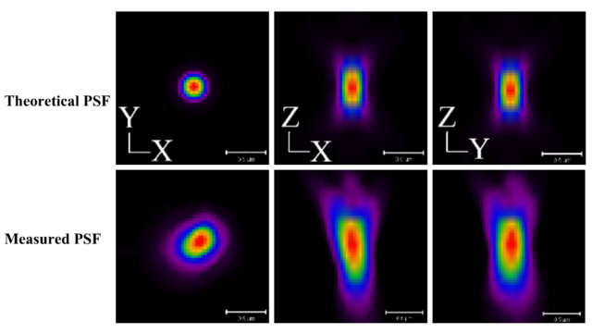
PSF – 3D spatial variations
support.svi.nl/wikiimg/Tycho_beads.jpg

Slide 5
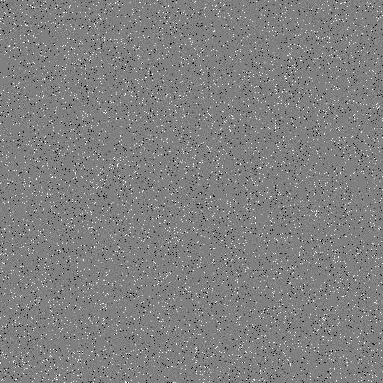
Salt and pepper noise

Slide 6
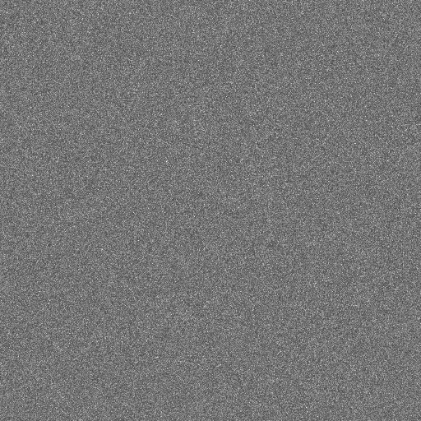
Shot noise

Slide 7
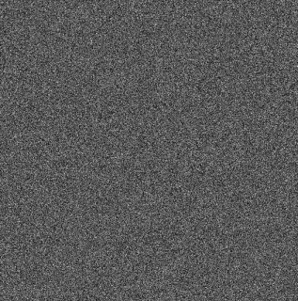
Dark current noise
http://www.mso.anu.edu.au/nifs/sdns/sdn0004.01_files/image007.gif

Slide 8
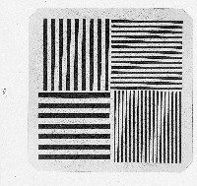
Test pattern + noise

Slide 9
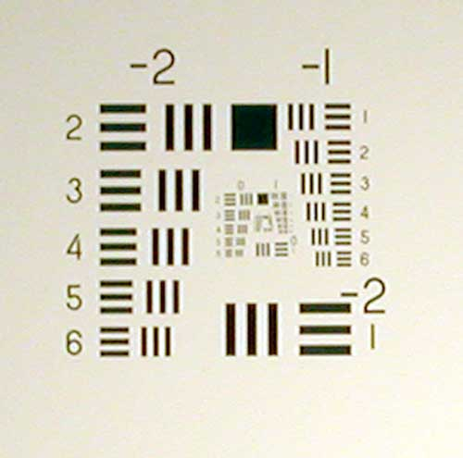
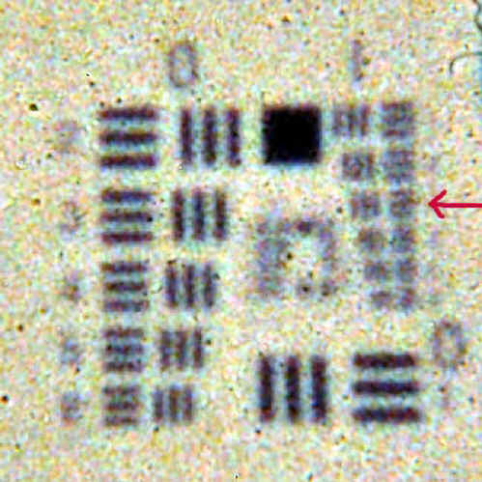
Test pattern + noise
http://www.crystalcanyons.net/pages/TechNotes/TechNoteImages/Film_Arrow.jpg

Slide 10
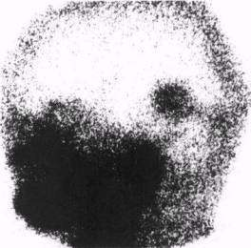
Gamma camera
http://www.cns-snc.ca/history/fifty_years/fedoruk13.jpg

Slide 11
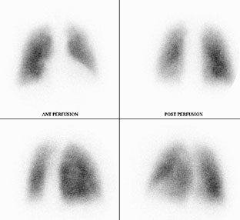
Gamma camera
Source: http://www.poole.nhs.uk/images/our_services/nuclear_medicine/lung_scan.jpg

Slide 12
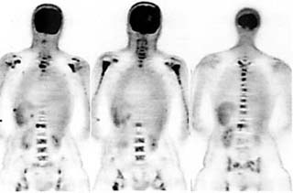
PET camera
Source: http://www.bocaradiology.com/Procedures/PET.html

Slide 13
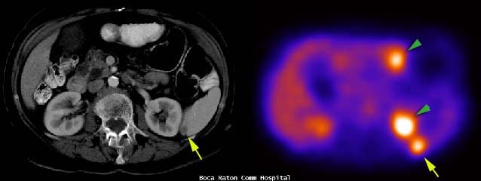
PET camera
CT
PET
(false colours)
Source: http://www.bocaradiology.com/Procedures/PET.html

Slide 14
Removing image distortions
A bit of frequency analysis revision …

Slide 15
Measuring and removing distortions
Blur
  Measure: Point spread function (PSF)
  Removal: deconvolution, high-pass filtering
Noise
  Measure: Signal to noise ratio (SNR)
  Removal: low-pass filtering, median filtering
General image quality
  Modulation Transfer Function (MTF)

Slide 16
Conclusions
Know your blur and noise characteristics
Minimise distortions when acquiring images
Remove the distortions if possible

